Slide 1
Digital Europe
Ministarstvo nauke, tehnološkog razvoja i inovacija
Prof. dr Miroslav Trajanović

Slide 2
Association agreements for the Digital Europe Programme
30.6.2023. the Commission signed association agreements for the Digital Europe Programme with Montenegro, North Macedonia, Albania and Serbia, on the margins of the Regulatory Dialogue with the Western Balkans.
Businesses, public administrations and other eligible organisations will be able to access the calls of the Digital Europe Programme
Participants will be able to take part in projects that deploy digital technologies across the EU in specific areas such as artificial intelligence, and advanced digital skills.
They will also be able to set up Digital Innovation Hubs in their own regions.

Slide 3
The Digital Europe Programme (DIGITAL)
New EU funding programme focused on bringing digital technology to businesses, citizens and public administrations
€7.5 Billion of funding for 2021-2027
Supporting projects in five key capacity areas:
supercomputing,
artificial intelligence,
cybersecurity,
advanced digital skills,
wide use of digital technologies across the economy and society, including through Digital Innovation Hubs

Slide 4
The Digital Europe Programme will reinforce EU’s critical digital capacities by focusing on the key areas of
artificial intelligence (AI), cybersecurity, advanced computing, data infrastructure, governance and processing, the deployment of these technologies
and their best use for critical sectors like
energy, climate change and environment, manufacturing, agriculture and health.

Slide 5
The Digital Europe Programme
2021-2022 Work programme – Završen
2023-2024 Work programme – Aktivan
2024-2027 Work programme / Tek treba da bude definisan

Slide 6
2023-2024 Work programme 2023 – EUR 392 million 2024 - EUR 517,5 million Most actions foreseen in the Digital Europe Programme require co-investments from the public and/or private sectors

Slide 7
Objectives
Address climate and environment protection challenges
Deployment of sectorial common data spaces, based on the secure and energy efficient federated cloud-to-edge infrastructure that are accessible to businesses and the public sector
Continue the work on the sectorial Testing and Experimentation Facilities funded under the WP 2021-2022 in order to develop a strong ecosystem that will enable faster adoption of AI technologies in Europe
Further support the excellence of EU education and training institutions in digital areas
Further invest in the uptake of blockchain in Europe

Slide 8
392 EUR million for actions in 2023
EUR 60 million for actions supporting the Destination Earth initiative including the core platform, data lake and related digital twins;
EUR 113 million for actions supporting the deployment of Common Data Spaces including sectorial data spaces and the supporting Cloud-to-Edge infrastructure and services, as well as further actions in regard to sectorial Testing and Experimentation Facilities for AI;
EUR 20 million for incidence response support and Preparedness of Key sectors in the area of cybersecurity;
EUR 86.8 million for actions related to deployment of digital technologies, such as the European Blockchain Services Infrastructure, activities in the area of sectorial IT solutions for justice and consumers, building confidence in digital transformation and deployment of solutions for public services, as well as support to Trans-European Services for Telematics between Administrations (TESTA);

Slide 9
392 EUR million for actions in 2023
EUR 58 million for actions on advanced digital skills in key capacity areas through specialised education programmes and other actions;
EUR 21.5 million for supporting Interoperable Europe actions that aim to ensure the development of interoperable trans-European digital public services;
EUR 10 million for Investment Platform for Strategic Digital Technologies;
EUR 22.7 million for other actions including programme support actions and support for Digital Services Act and Digital Markets Act IT systems as well as supporting the continuous operation and/or evolution of the IT system of the central gateway for EU Digital COVID Certificate standards and specifications.

Slide 10
Co-investments
Investments under Digital Europe Programme are complementary to investments under a number of EU funding instruments
Examples:
EU4Health programme aims at reinforcing health data, digital tools and services, enhance access to healthcare and support its digital transformation
Justice Programme offers funding opportunities in the e-justice field supporting transnational projects
Common Agricultural Policy (CAP): Investments into digitalisation in agriculture and rural areas

Slide 11
Co-investments
Most actions foreseen in the Digital Europe Programme require co-investments from the public and/or private sectors.
The modes of these co-investments are described in the relevant parts of the various work programmes.
Alternating or cumulative funding
In no circumstances the same costs shall be financed twice by the EU budget

Slide 12
Alternating/sequenced funding
Occurs when each instrument finances a different part of the operation/action, or finances successive parts.
It requires a split of an operation/action in two different parts.
Separate grant agreements are required, applying the rules of the funding instruments respectively.
Coordination is required to avoid double funding, ensuring separation of parts/activities.
Expenditure used for a reimbursement request for one instrument shall not be declared for support from another Fund or Union instrument.
Activities financed under separate instruments have to be clearly differentiated.

Slide 13
Cumulative funding
An action receives support from more than one fund, programme or instrument (including both shared and directly managed funds).
Two grant agreements are required, applying the rules of each of the funding instrument respectively.
A number of steps starting from preparation, through linking of actions, grant signatures all the way to reporting and payments need to be followed
Co-ordination is required to avoid double funding by coordinating the funding rates which in combination cannot go over 100% of the eligible costs.

Slide 14
First set of calls with a common deadline 26.9.2023
Area | Topics in the Work Programme | Digital Europe Funding rate
Cloud to edge infrastructure | Highly Secure Collaborative Platform for Aeronautics and Security Industry | 50%
Data | Federated European Infrastructure for Intensive Care Units’data | 50%
 | Genome of Europe | 50%
 | Digital Product Passport | 50%
AI | Developing CitiVerse | 50%
Advanced Digital Skills | Reinforcing Skills in semiconductors | 50%
 | Cybersecurity Skills Academy | 50%
Confidence in Digital Transformation | Network of Safer internet Centres (SICs) | 50%
 | European Digital Media Observatory (EDMO) - national and multinational hubs | 75% for SMEs and 50% for all other beneficiaries
Accelerating the Best Use of Technologies | EU Energy Saving Reference Framework | 50%

Slide 15
Second set of calls with a common deadline in 2023
Area | Topics in the Work Programme | Digital Europe Funding rate
Data | Data Space for Cultural Heritage | 50%
 | Data Space for Tourism | 50%
Advanced Digital Skills | Specialised Education Programmes or Modules in KeyCapacity Areas | 50%

Slide 16
MULTI COUNTRY PROJECTS (MPC) AND THE EUROPEAN DIGITAL INFRASTRUCTURE CONSORTIA
Part of the Path to Digital Decade policy programme
MCPs are large-scale deployment and capacity-building projects for the digital transformation of the Union, facilitating the achievement of the Digital Decade objectives and targets
Coordinated investments between the EU, Member States and private stakeholders
Enables digital infrastructure projects that one single Member State could not deploy on its own

Slide 17
Multi Country Projects relevant for this Work Programme
MCPs relevant for this Work Programme | Topics in this Digital Europe Work Programme
European Common data infrastructure and services | 2.1.1 Cloud IPCEI Exploitation Office 2.2.1 Data Spaces 2.2.3 Support for data for EU
Genomics | 2.2.1.4.1 Genome of Europe
Processors and semiconductors chips | 2.3.1.1 Coordination of AI sectorial Testing and Experimentation Facilities
Connected public administration | 5.2.1 European Digital Government Ecosystem 5.2.2 Interoperable Europe - Interoperability for the public sector
European Blockchain Services Infrastructure | 5.1 Blockchain

Slide 18
Multi Country Projects relevant for this Work Programme
MCPs relevant for this Work Programme | Topics in this Digital Europe Work Programme
European Common data infrastructure and services | 2.1.1 Cloud IPCEI Exploitation Office 2.2.1 Data Spaces 2.2.3 Support for data for EU
Genomics | 2.2.1.4.1 Genome of Europe
Processors and semiconductors chips | 2.3.1.1 Coordination of AI sectorial Testing and Experimentation Facilities
Connected public administration | 5.2.1 European Digital Government Ecosystem 5.2.2 Interoperable Europe - Interoperability for the public sector
European Blockchain Services Infrastructure | 5.1 Blockchain
High-tech partnerships for digital skills and specialized education | 4. Advanced Digital Skills

Slide 19
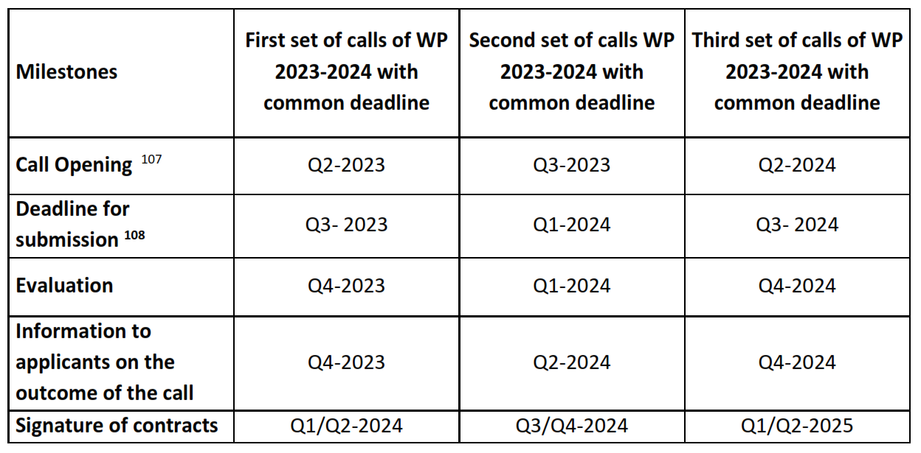
Call timeline for topics

Slide 20
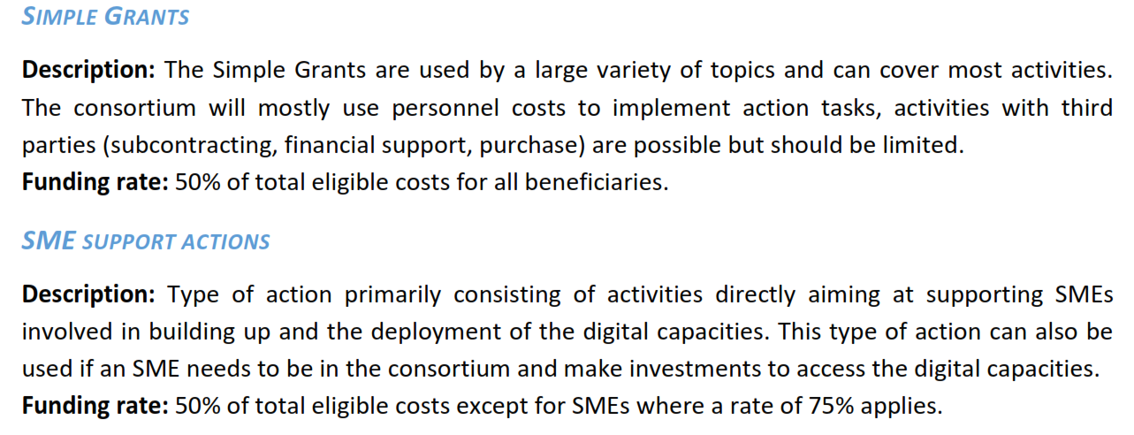
Types of action to be implemented through grants

Slide 21
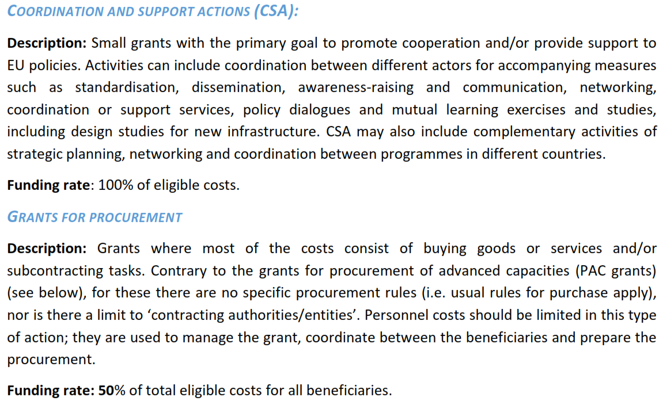
Types of action to be implemented through grants (2)

Slide 22
Types of action to be implemented through grants (3)

Slide 23
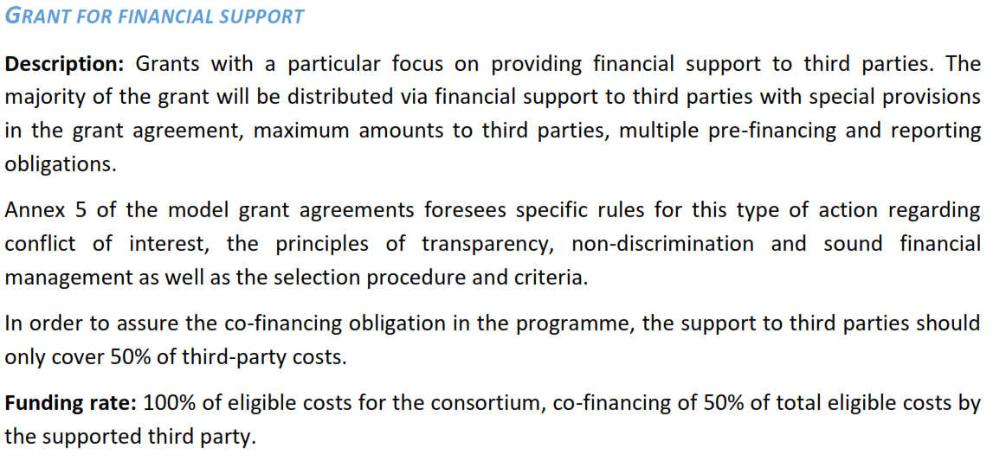
Types of action to be implemented through grants (4)

Slide 24
Types of action to be implemented through grants (5)
SGA Funding rate: 50% of total eligible costs.
Interoperable Europe: GovTech Incubator

Slide 25
Types of action to be implemented through grants (6)

Slide 26
Open calls – First set of calls 2023
Current 19
https://ec.europa.eu/info/funding-tenders/opportunities/portal/screen/opportunities/topic-search;callCode=null;freeTextSearchKeyword=;matchWholeText=true;typeCodes=1,0;statusCodes=31094501,31094502,31094503;programmePeriod=2021%20-%202027;programCcm2Id=43152860;programDivisionCode=null;focusAreaCode=null;destinationGroup=null;missionGroup=null;geographicalZonesCode=null;programmeDivisionProspect=null;startDateLte=null;startDateGte=null;crossCuttingPriorityCode=null;cpvCode=null;performanceOfDelivery=null;sortQuery=sortStatus;orderBy=asc;onlyTenders=false;topicListKey=topicSearchTablePageState

Slide 27
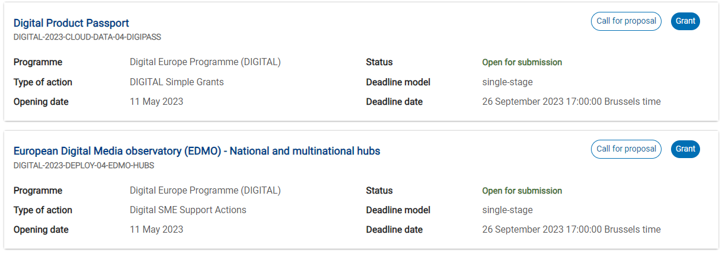
Open calls - examples
50%
75%

Slide 28
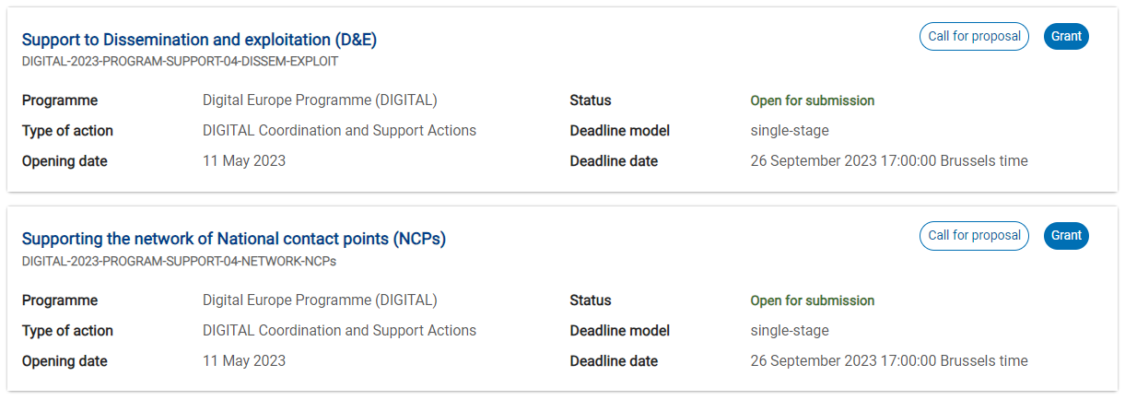
Open calls - examples
100%
100%

Slide 29
15 otvorenih poziva u kojima mogu učestvovati organizacije iz Srbije
Deployment of the AI-on-demand platform ( rok za prijavu: 29.08.2023)
Rok za prijavu 26.9.2023.
Reinforcing skills in semiconductors
EU Energy saving reference framework
Network of safer Internet Centres (SICs)
Digital Product Passport
Boosting Digital Skills of young pupils, in particular girls
European Digital Media observatory (EDMO) - National and multinational hubs

Slide 30
15 otvorenih poziva u kojima mogu učestvovati organizacije iz Srbije (2)
Rok za prijavu 22.11.2023.
Genome of Europe
Federated European Infrastructure for intensive care units' (ICU) data
Cloud IPCEI exploitation office
Coordination of AI sectorial testing and experimentation facilities
Support to Dissemination and exploitation
Supporting the network of National contact points (NCPs)
Developing citiverse
Highly secure collaborative platform for aeronautics and security industry

Slide 31
Deployment of the AI-on-demand platform
The platform will gather all the AI resources (algorithms and tools), and make them available to the potential users, businesses and public administration, with the necessary services to facilitate their integration.
Deliverable: The European AI-on-demand platform, including
o A visible and secure catalogue of trustworthy AI resources made in Europe
o A one-stop shop to access AI tools for European industry and public administrations
o A reference and trusted marketplace for trustworthy AI resources
o A platform embedding a quality stamp recognised and accepted by the European industry and public administrations.
o Services in support of the public procurement of AI solutions
Rok za prijavu: 29.08.2023

Slide 32
Reinforcing skills in semiconductors
The proposed project is required to develop a European Semiconductors Skills Academy: a European network of higher education institutions and relevant industries, including start-ups and SMEs in microelectronics, to address the above issues.
Concerning the projects addressing the Academic network Definition of the required curricula using the ECTS system with capacity for around 500 students/year across at least 5 Member States, for BSc and MSc levels.
On-the-job experiences for undergraduate students in companies involved in the consortium.
Upgrade of laboratories used for the teaching activities delivered by the project.
Local or regional programmes led by the industrial partner(s) to target secondary school students, including for example a Summer/Winter School based on practical learning activities, introductory seminars, visit to facilities etc.
The proposed project is requested to define a platform among Vocational and Educational Training (VET) centres, industry, in particular start-ups and SMEs, academia, and social partners to address the need of continuing vocational training to enhance employability.
26 September 2023 17:00:00 Brussels time

Slide 33
EU Energy saving reference framework
The objective of this call for proposals is to establish and promote the widespread adoption of a Common European Reference Framework (CERF) for energy saving applications throughout the EU. This framework will include an open-source reference implementation, for energy and cost saving consumer applications. This reference framework is designed for integration into both commercial and non-commercial applications.
Outcomes:
- A scalable and interoperable European open-source reference framework for a consumer application that enables voluntary reductions in energy consumption based on grid and energy consumption data. This framework should integrate eco-tips, blackout prevention strategies, energy cost-saving measures, and incentives to encourage load shifting, ultimately promoting sustainable energy usage.
- Specifications of suitable data sets and digital environment for providing realtime feedback to consumers, including relevant information about the energy mix, local grid status, electricity consumption, and corresponding energy saving advice.
26 September 2023 17:00:00 Brussels time

Slide 34
Network of safer Internet Centres (SICs)
The objective of the topic is to continue to support national SICs which may be composed of one or more NGOs, government bodies/agencies, private sector organisations in providing online safety information, educational resources, public awareness tools and counselling and reporting services (through dedicated helplines and hotlines) for young people, teachers, and parents. The activities performed by the SICs will help minors to tackle online risks and to become media-literate, resilient, digital citizens, and will allow citizens to anonymously report online child sexual abuse material (CSAM).
To reach all children, the Safer Internet Centres will pay particular attention to children with special or specific needs, including those from disadvantaged and vulnerable backgrounds.
26 September 2023 17:00:00 Brussels time

Slide 35
Digital Product Passport
Expected Outcome: Deployed and validated at scale and real life setting Digital Product Passports in at least two value chains. Report on further needs for standardisation and specifications to ensure interoperability, security and acceptance by all the stakeholders. Recommendations based on the lessons learnt for the deployments of DPP in other value chains.
Objective: To enable sharing of key product related information that are essential for products’ sustainability and circularity, including those specified in Annex III of ESPR proposal, across all the relevant economic actors. Consequently, to accelerate the transition to circular economy, boosting material and energy efficiency, extending products lifetimes and optimizing products design, manufacturing, use and end of life handling.
To provide new business opportunities to economic actors through circular value retention and optimisation (for example product-as-a-service activities, improved repair, servicing, remanufacturing, and recycling) based on improved access to data;
To help consumers in making sustainable choices; and
To allow authorities to verify compliance with legal obligations.
26 September 2023 17:00:00 Brussels time

Slide 36
Boosting Digital Skills of young pupils, in particular girls
Scope: The aim of this action is to pilot actions to increase the number of students pursuing digital studies and careers, with a special focus on increasing participation of girls. It will support joint actions between leading technical higher education institutions, businesses and schools to promote digital studies, through hands-on activities and challenge-based projects.
ExpectedOutcome:Stronger cooperation between primary, secondary and VET schools and tertiary education and research to increase the number of pupils enrolling in digital studies aiming at gender convergence. This will lead to the development of:
Summer schools
Specialised information and career days
Dissemination and outreach activities, such as EU Code Week
26 September 2023 17:00:00 Brussels time

Slide 37
European Digital Media observatory (EDMO) - National and multinational hubs
The European Digital Media Observatory (EDMO) has been created with the aim of supporting an independent multidisciplinary community to tackle the phenomenon of disinformation. EDMO is composed of a central platform and governance which support and coordinate the work of the EDMO national/multinational hubs.
The objective of this topic is to finance the work of independent national /multinational hubs for analysis of digital media ecosystems in order to ensure the coverage of geographical areas covered by the EDMO hubs for which the funding is ending at the end of 2023 and in 2024.
At the end of the actions, a network of existing and newly established research hubs will be active across the EU under the coordination of EDMO.
Networks of experts and organisations linked to the hubs will be part of a European multidisciplinary community which will actively detect, analyse and expose disinformation campaigns in Europe.
26 September 2023 17:00:00 Brussels time

Slide 38
Genome of Europe
Objective: This action will support the implementation of the Genome of Europe (GoE) multi-country project and contribute to achieving the objectives and long-term ambition of the 1+Million Genomes (1+MG) initiative. GoE aims to establish and launch a European reference genome database of genetic variation obtained by whole genome sequencing (WGS) for at least 500,000 citizens based on population-based national reference genome collections, collectively representative of the European population.
Scope: The biological samples needed to generate the data, i.e., to sequence the genomes, can either originate from existing population-based cohorts and national biobanks, or be collected from participants recruited specifically for the national and European GoE reference databases. The participants will be selected at the national level to be representative of the respective population, including a contribution of relevant minorities.
22 November 2023 17:00:00 Brussels time

Slide 39
Federated European Infrastructure for intensive care units' (ICU) data
The action will establish and deploy a pan-European federated infrastructure for Intensive Care Units’ (ICU) data combined with governance mechanisms allowing secure cross-border access and use of ICU datasets, related tools and resources. The infrastructure shall primarily address data from acute and intensive care, including data generated from physiological monitors, laboratory investigations, imaging, clinical examination and examination protocols, and therapeutics as well as from emerging omics technologies used during care delivery.
The awarded action will support the deployment of the infrastructure needed to link and enable access and exploration of the fragmented European databases of ICUs on acute care, intensive care and telemedicine, complemented by a solid, clear and sustainable governance and business model for gathering data, models and best practice, and its exploitation by public and private organisations towards clear benefits for health communities and society.
22 November 2023 17:00:00 Brussels time

Slide 40
Cloud IPCEI exploitation office
Objective: This action will support the overall coordination, monitoring, dissemination and long-term exploitation of the activities within the pre-notified Important Project of Common European Interest on Next Generation Cloud and Edge Infrastructure and Services (IPCEI-CIS) via the set-up of a Cloud IPCEI Exploitation Office. The Office’s objective is to disseminate the results of this IPCEI and contribute to the exploitation and re-use of its solutions including by those interested Member States, companies and Research and Technology Organisations (RTOs) that will not be participating in the IPCEI-CIS.
The pre-notified IPCEI-CIS aims at developing and industrially deploying, for the first time, a fundamentally new, innovative, secure and sustainable data processing production process spanning across the European Union. It will develop and deploy breakthrough technological cloud and edge computing capabilities and very high added value data processing industrial services.
22 November 2023 17:00:00 Brussels time

Slide 41
Coordination of AI sectorial testing and experimentation facilities
The Coordination and support action (CSA) grant will support the sectorial Testing and Experimentation Facilities (TEFs) created under the WP 2021-2022 (Health, Manufacturing, Agri-Food, Smart Cities and Communities) and the future new ones to be created under the Digital Europe Programme, to develop complementary cross-TEF activities in providing AI services from a cross-sector perspective, to maximise the overall impact of TEFs in their ambitions of achieving world-class excellence and to help the sectorial TEFs to better link with relevant EU projects, initiatives and stakeholders in the AI ecosystem of excellence.
It will support TEFs to help companies using their services to comply with the AI Act. This could be through regulatory sandboxes, standards, certifications, labelling schemes, assessment of transparency of AI systems and collaboration with public authorities, depending on what TEF themselves offer and what additional or complementary support to the TEF users is needed.
22 November 2023 17:00:00 Brussels time

Slide 42
Support to Dissemination and exploitation
Maximise the impact of the Digital Europe Programme and the take up of its results through a Dissemination and Exploitation (D&E) conceptual and operational framework, including the delivery of a number of practical actions.
A conceptual and operational framework for D&E taking into account the elements mentioned under “scope” and offering solid methodological and practical approaches.
A proposal for a set of actions to be implemented by the different stakeholders and a plan to deliver on the framework, with monitoring and evaluation metrics.
The implementation of relevant actions aiming at e.g. supporting and complementing individual projects efforts in their D&E activities.
22 November 2023 17:00:00 Brussels time

Slide 43
Supporting the network of National contact points (NCPs)
This action will support the coordination between different National Contact Points (NCPs) for the Digital Europe Programme, the preparation and execution of actions that maximise awareness and the impact of the programme and the long-term dissemination and exploitation of results.
The action is expected to contribute to the following outcomes:
• Improved and professionalised NCP services across Europe, supporting access to Digital Europe Programme calls, lowering the entry barriers for newcomers,and raising the average quality of proposals submitted;
• Robust NCP support services across Europe that are adapted to specific objectives of Digital Europe Programme, including;
o more participation of new players in the programme;
o matchmaking activities to connect potential participants from widening countries with emerging consortia in this thematic area using a variety of tools;
o dissemination of information about security and ownership control rules in Digital Europe Programme for applicants.
22 November 2023 17:00:00 Brussels time

Slide 44
Developing citiverse
The action will implement the CitiVerse concept by building on the smart communities’ data infrastructure that is developed under WP2021-22 and WP23-24.
The objective is to bring EU CitiVerse industry, including SMEs, together in developing the different layers and technical components of virtual worlds useful for local authorities and citizens.
The action could build on existing local digital twins and smart communities’ data infrastructure expanding their capabilities and further shifting to eXtended Reality. One or more projects, led by the industry in cooperation with one or more EU communities, will introduce virtual world technology to allow citizens and other stakeholders to «navigate and interact» in their community spaces. This could range from basic ‘default’ sensory experiences all the way to digital asset –enhanced overlays. This will create a steady and immersive environment for citizens and businesses, a CitiVerse, that can be used for virtual/real spatial planning, management or navigation while also enhancing the social, architectural, green, and cultural heritage dimension of living spaces.
22 November 2023 17:00:00 Brussels time

Slide 45
Highly secure collaborative platform for aeronautics and security industry
The objective is to develop a commercially viable highly secure cloud-based collaborative platform for the management of sensitive multi-country industrial initiatives in the aeronautics and security sector, including civil security. This platform will allow the development of highly sensitive industrial projects, from design to production. In particular, the platform should be able to support the development of products and services financed under future calls of the European Defence Fund.
Allow the aeronautics and security sector to reach a similar level of decentralised/distributed working along its supply chain in the same way as other sectors already enjoy it today (e.g. the automotive sector).
Be cloud-native or in its defect, cloud-based (i.e. deployable and operated from a highly-secure cloud infrastructure), as opposed to on-premise software.
Provide for a broad range of secure and user-friendly collaborative tools including general purpose collaboration tools (messaging, wikis, file sharing, videoconferencing, chat) as well as more advanced tools (computer-assisted design, product lifecycle management, data analysis, …).
?
22 November 2023 17:00:00 Brussels time

Slide 46
Data Space for tourism
Expected outcome and Deliverables
Infrastructure for the Tourism Data Space.
Connections between relevant local and national data ecosystems and initiatives at EU level.
Establish connections with other sectoral data spaces.
Guidance/training documents to involve stakeholders in sharing data.
Exploitation of available data for better interconnection, exchange of information and reuse.
Once the data space is operational, regular updates on usage data and troubleshooting.
23 January 2024

Slide 47
Data Space for Cultural heritage
Expected outcome and Deliverables
Frameworks, tools, technologies, storage and processing capacities for making advanced 3D and XR data available in the data space.
High quality 3D and XR content and documentation made available in the data space.
New high-value datasets available for re-use, in particular 3D datasets, including for conducting scientific research, preservation and restoration purposes, re-use by the cultural and creative sector and other domains such as education.
Training and capacity building for cultural heritage institutions in making use of 3D and XR technologies

Slide 48
Hvala na pažnji
Pitanja bez odgovora

